Slide 1
RESEARCH DESIGN AND MACHINE LEARNING
Alexander Egorenkov
Lead Instructor, General Assembly

Slide 2
LEARNING OBJECTIVES
EXPERIMENTAL DESIGN AND PANDAS
Define a problem and types of data
Identify data set types
Define the data science workflow
Introduce machine learning and its role in data science

Slide 3
OPENING
EXPERIMENTAL DESIGN AND PANDAS

Slide 4
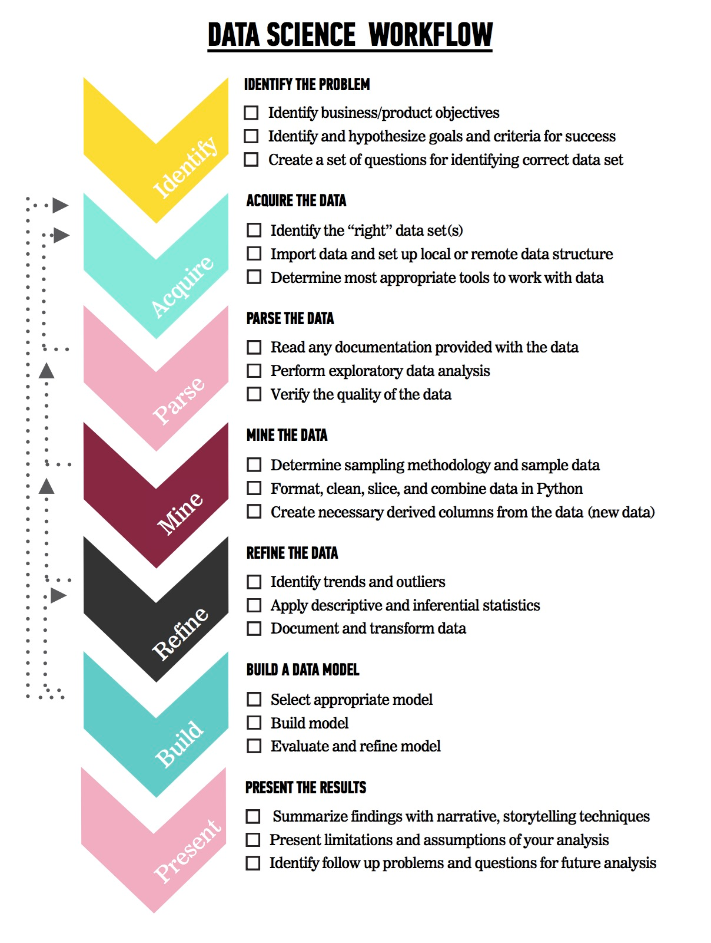
LET’S REVIEW THE DATA SCIENCE WORKFLOW
The steps:
Identify the problem
Acquire the data
Parse the data
Mine the data
Refine the data
Build a data model
Present the results

Slide 5
TODAY
We’re going to focus on steps 1-2 (Identify the Problem and Acquire the Data).
We’ll cover steps 3-5 in the next few classes

Slide 6
INTRODUCTION
ASKING A GOOD QUESTION

Slide 7
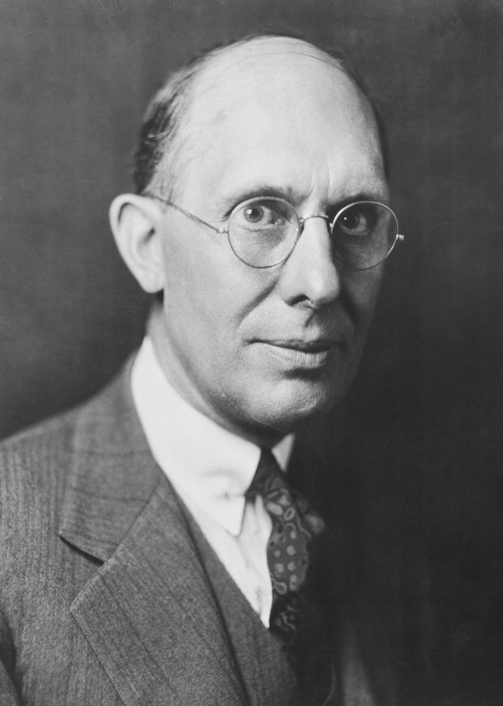
WHY DO WE NEED A GOOD QUESTION?
“A problem well stated is half solved.” -Charles Kettering
Sets yourself up for success as you begin analysis
Establishes the basis for reproducibility
Enables collaboration through clear goals

Slide 8
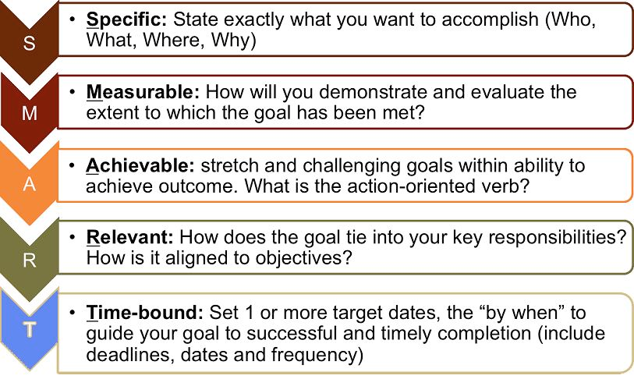
WHAT IS A GOOD QUESTION?
Goals are similar to the SMART Goals Framework.
S: specific
M: measurable
A: attainable
R: reproducible
T: time-bound

Slide 9
WHAT IS A GOOD QUESTION?
Specific: The dataset and key variables are clearly defined.
Measurable: The type of analysis and major assumptions are articulated.
Attainable: The question you are asking is feasible for your dataset and is not likely to be biased.
Reproducible: Another person (or future you) can read and understand exactly how your analysis is performed.
Time-bound: You clearly state the time period and population for which this analysis will pertain.

Slide 10
WHAT IS A GOOD QUESTION?

Slide 11
DEMO
DIAGRAMMING AN AIM

Slide 12
EXAMPLE AIM
Determine the association of foods in the home with child dietary intake. Using one 24-hour recall from the cross-sectional NHANES 2007-2010 we will determine the factors associated with food available in the homes of American children and adolescents. We will test if reported availability of fruits, dark green vegetables, low fat milk or sugar sweetened beverages available in the home increases the likelihood that children and adolescents will meet their USDA recommended dietary intake for that food.

Slide 13

HYPOTHESIS
Children will be more likely to meet the USDA recommended intake level when food is always available in their home compared to rarely or never.

Slide 14
SPECIFIC
How data was collected:
24-hour recall, self-reported
What data was collected:
Fruits, dark green vegetables, low fat milk or sugar sweetened beverages, always vs. rarely available
How data will be analyzed:
Using USDA recommendations as a gold-standard to measure the association
The specific hypothesis & direction of the expected associations:
Children will be more likely to meet their recommended intake level

Slide 15
MEASURABLE
Determine the association of foods in the home with child dietary intake.
We will test if the reported availability of certain foods increases the likelihood that children and adolescents will meet their USDA recommended dietary intake for food.

Slide 16
ATTAINABLE
Cross-sectional data has inherent limitations; one of the most common is that causal inference is typically not possible.
Note that we are determining association, not causation.

Slide 17
REPRODUCIBLE
With all the specifics, it would be straightforward to pull the data from NHANES and reproduce the analysis.

Slide 18
TIME BOUND
Using one 24-hour recall from NHANES 2007-2010, we will determine the factors associated with food available in the homes of American children and adolescents.

Slide 19
CONTEXT IS IMPORTANT
The previous example laid out research goals.
In a business setting, you will need to articulate business objectives.
Example: Success for the Netflix recommendation engine may be if 70% of customers over the age of 18 select a movie from the recommended queue during Q3 of 2015.
Regardless of setting, start your question with the SMART framework to help achieve your objectives.

Slide 20

ACTIVITY: KNOWLEDGE CHECK
ANSWER THE FOLLOWING QUESTIONS (5 minutes)
EXERCISE
Which of the following uses the SMART framework? Why? What is missing?
I am looking to see if there is an association with number of passengers with carry on luggage and delayed take-off time.
Determine if the number of passengers on JetBlue, Delta and United domestic flights with carry-on luggage is associated with delayed take-off time using data from flightstats.com from January 2015- December 2015.
DELIVERABLE
Answers to the above questions

Slide 21
WHY DATA TYPES MATTER
Different data types have different limitations and strengths.
Certain types of analyses aren’t possible with certain data types.

Slide 22
CROSS-SECTIONAL DATA
All information is determined at the same time; all data comes from the same time period.
Issues: There is no distinction between exposure and outcome

Slide 23
CROSS-SECTIONAL DATA
Strengths
Often population based
Generalizability
Reduce cost compared to other types of data collection methods
Weaknesses
Separation of cause and effect may be difficult (or impossible)
Variables/cases with long duration are over-represented

Slide 24
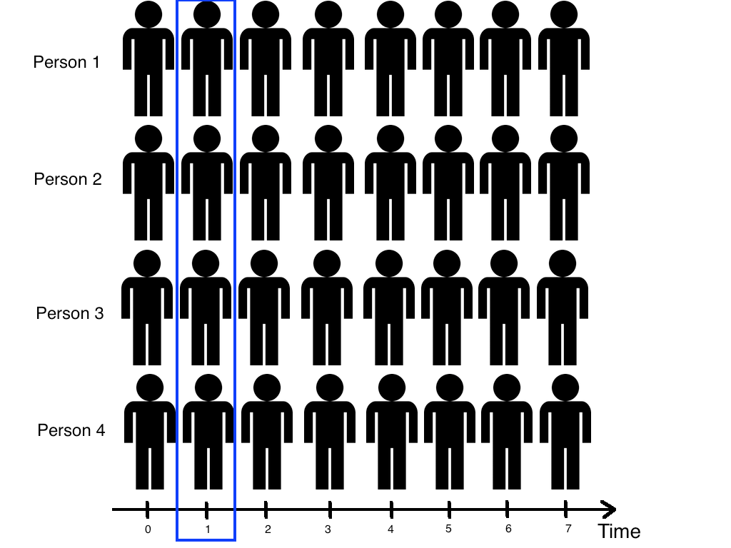
CROSS-SECTIONAL DATA

Slide 25
TIME SERIES/LONGITUDINAL DATA
The information is collected over a period of time
Strengths
Unambiguous temporal sequence - exposure precedes outcome
Multiple outcomes can be measured
Weaknesses
Expense
Takes a long time to collect data
Vulnerable to missing data

Slide 26
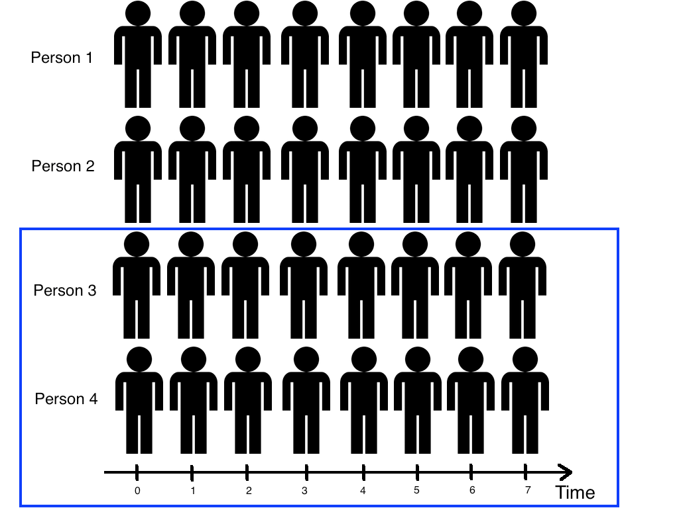
TIME SERIES/LONGITUDINAL DATA

Slide 27
ACTIVITY: KNOWLEDGE CHECK
ANSWER THE FOLLOWING QUESTIONS (5 minutes)
EXERCISE
What type of data is the flightstats data?
Determine if the number of passengers on JetBlue, Delta and United domestic flights with carry-on luggage is associated with delayed take-off time using data from flightstats.com from January 2015- December 2015.
Can you create a cross-sectional analysis from a longitudinal data collection? How?
DELIVERABLE
Answers to the above questions

Slide 28
GUIDED PRACTICE
WRITE A RESEARCH QUESTION WITH RAW DATA

Slide 29
ACTIVITY: WRITE A RESEARCH QUESTION WITH RAW DATA
DIRECTIONS (10 minutes)
EXERCISE
Individually, look at the data from Kaggle’s Titanic competition and write a high quality research question.
Make sure you answer the following questions:
What type of data is this, cross-sectional or longitudinal?
What will we be measuring?
What is the SMART aim for this data?
When finished, split into pairs and share your answers with each other.
DELIVERABLE
Research Question

Slide 30
INTRODUCTION
WHAT ARE SOME COMMON QUESTIONS?

Slide 31
WHAT ARE SOME COMMON QUESTIONS?
Machine learning more or less asks the following questions:
Does X predict y? Where X is a set of data and y is an outcome.
What are the key components of our data?
Are there any distinct groups in our data?
Is one of our observations “weird”?
This seems limited, but we rewrite questions to fit this form.

Slide 32
WHAT ARE SOME COMMON QUESTIONS?
From a business perspective:
What is the likelihood a customer will buy this product?
Is this a good or bad review?
How much demand will there be for my service tomorrow?
Is this the cheapest way to deliver my goods?
Is there a better way to segment my marketing attempts?
What groups of products are purchased together?
Can we automate this decision?
There are an endless amount of examples from various fields.

Slide 33
CLASS ACTIVITY: REWRITING QUESTIONS
ANSWER THE FOLLOWING QUESTIONS (10 minutes)
EXERCISE
How do the machine learning questions fit with the business application question in the previous slide?
DELIVERABLE
Answers to the above questions

Slide 34
DATA SCIENCE MACHINE LEARNING

Slide 35
I. WHAT IS MACHINE LEARNING? II. SUPERVISED LEARNING III. UNSUPERVISED LEARNING
AGENDA

Slide 36
INTRODUCTION
I. WHAT IS MACHINE LEARNING?

Slide 37
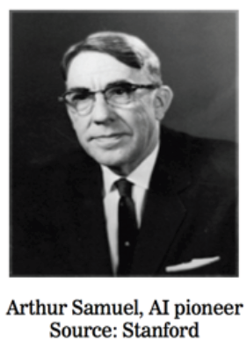
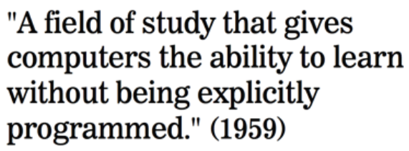
WHAT IS MACHINE LEARNING?

Slide 38

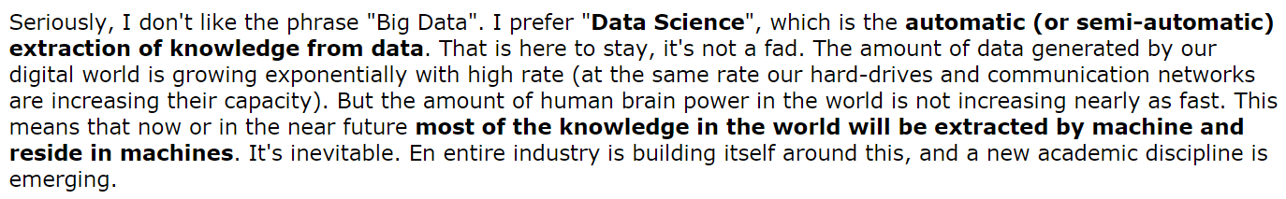
WHAT IS MACHINE LEARNING?
Source: http://www.reddit.com/r/MachineLearning/comments/25lnbt/ama_yann_lecun

Slide 39
WHAT IS MACHINE LEARNING?
One definition: “Machine learning is the semi-automatic extraction of knowledge from data.”
Knowledge from data: Starts with a question that might be answerable using data
Automatic extraction: A computer provides the insight
Semi-automatic: Requires many smart decisions by a human

Slide 40
INTRODUCTION
II. SUPERVISED LEARNING

Slide 41
TYPES OF MACHINE LEARNING
There are two main categories of machine learning: supervised learning and unsupervised learning.
Supervised learning (aka “predictive modeling”):
Predict an outcome based on input data
Example: predict whether an email is spam or ham
Goal is “generalization”

Slide 42
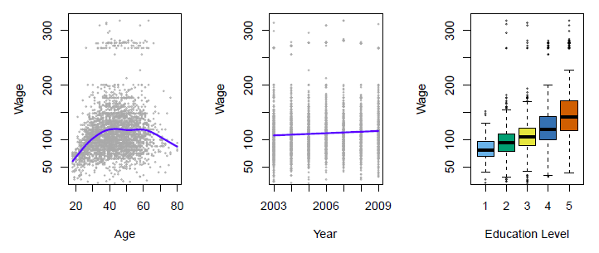
SUPERVISED LEARNING
Predict salary using demographic data
Income survey data for males from the central Atlantic region of the USA in 2009
Source: https://class.stanford.edu/c4x/HumanitiesScience/StatLearning/asset/introduction.pdf

Slide 43
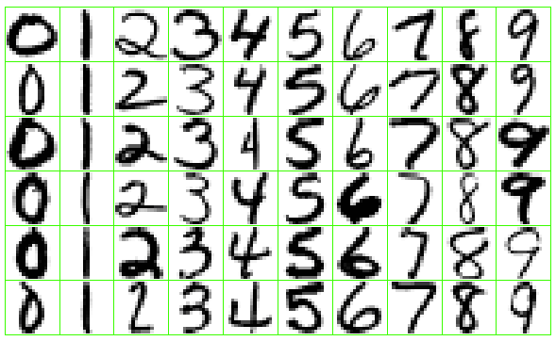
SUPERVISED LEARNING
Identify the numbers in a handwritten zip code
Source: https://class.stanford.edu/c4x/HumanitiesScience/StatLearning/asset/introduction.pdf

Slide 44
SUPERVISED LEARNING
There are two categories of supervised learning:
Regression
Outcome we are trying to predict is continuous
Examples: price, blood pressure
Classification
Outcome we are trying to predict is categorical (values in a finite set)
Examples: spam/ham, cancer class of tissue sample

Slide 45
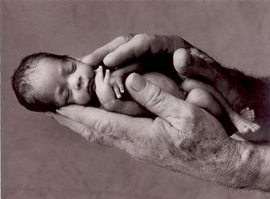
REGRESSION OR CLASSIFICATION?
Problem: Children born prematurely are at high risk of developing infections, many of which are not detected until after the baby is sick
Goal: Detect subtle patterns in the data that predicts infection before it occurs
Data: 16 vital signs such as heart rate, respiration rate, blood pressure, etc…
Impact: Model is able to predict the onset of infection 24 hours before the traditional symptoms of infection appear
Image: http://www.babycaretips4u.com/wp-content/uploads/2014/03/premature-baby.jpg
Case Study: http://www.amazon.com/Big-Data-Revolution-Transform-Think/dp/0544002695

Slide 46
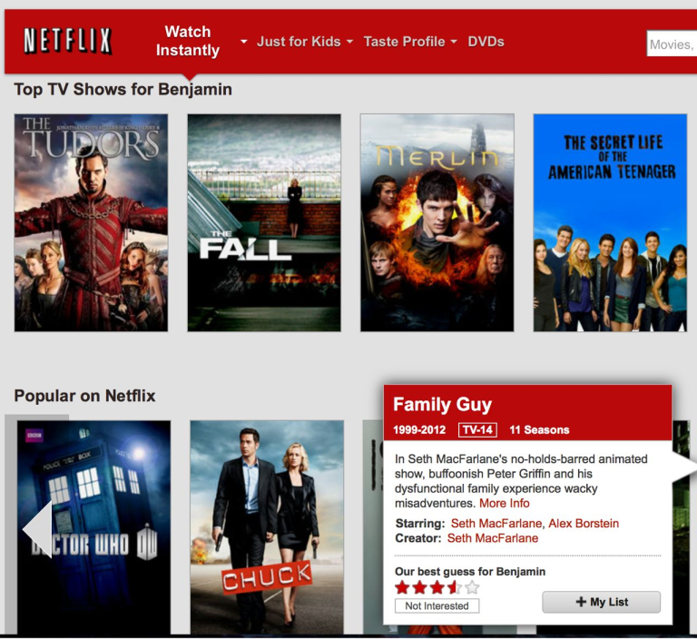
REGRESSION OR CLASSIFICATION?

Slide 47
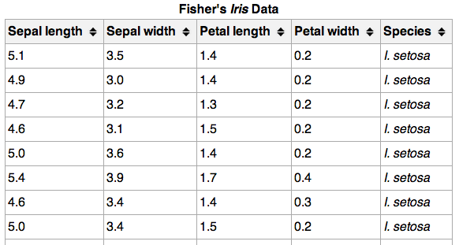
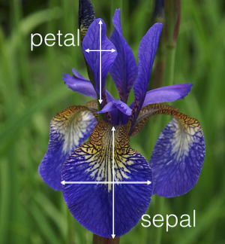
REGRESSION OR CLASSIFICATION?

Slide 48
MACHINE LEARNING TERMINOLOGY
}
_{150 observations}
_{(n = 150)}
{
{
Feature matrix “X” has n rows and p columns
Response “y” is a vector with length n
response
_{4 features (p = 4)}

Slide 49
MACHINE LEARNING TERMINOLOGY
Observations are also known as: samples, examples, instances, records
Features are also known as: predictors, independent variables, inputs, regressors, covariates, attributes
Response is also known as: outcome, label, target, dependent variable
Regression problems have a continuous response. Classification problems have a categorical response. The type of supervised learning problem has nothing to do with the features!

Slide 50
SUPERVISED LEARNING
How does supervised learning “work”?
Train a machine learning model using labeled data
“Labeled data” is data with a response variable
“Machine learning model” learns the relationship between the features and the response
Make predictions on new data for which the response is unknown
The primary goal of supervised learning is to build a model that “generalizes”: It accurately predicts the future rather than the past!

Slide 51
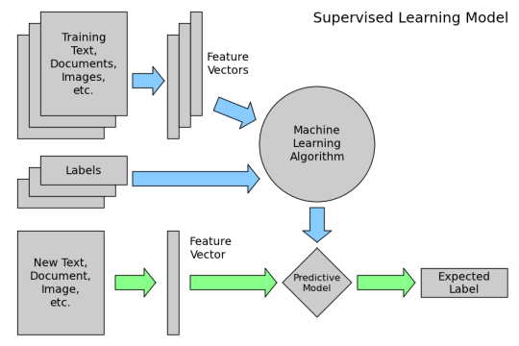
SUPERVISED LEARNING
How does supervised learning “work”?

Slide 52
SUPERVISED LEARNING
Supervised learning example: Coin classifier
Observations: Coins
Features: Size and mass
Response: Coin type, hand-labeled
Train a machine learning model using labeled data
Model learns the relationship between the features and the coin type
Make predictions on new data for which the response is unknown
Give it a new coin, predicts the coin type automatically

Slide 53
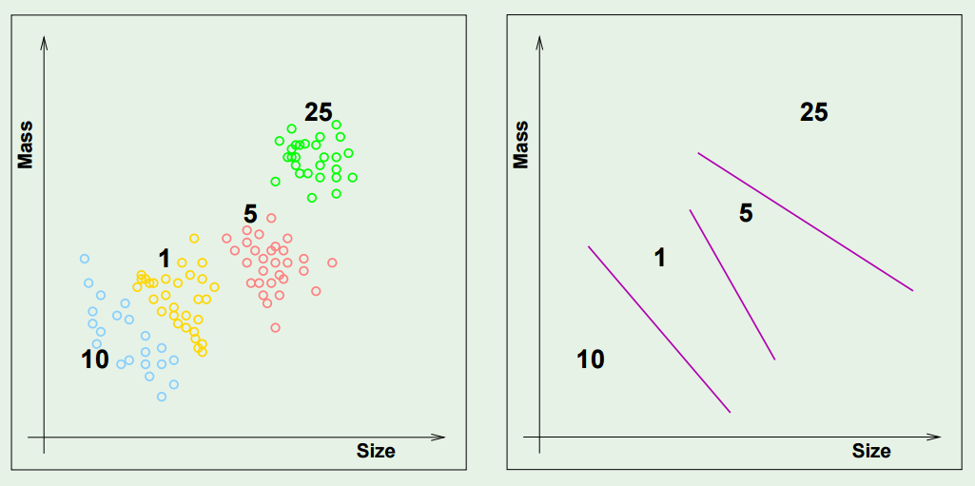
SUPERVISED LEARNING

Slide 54
INTRODUCTION
III. UNSUPERVISED LEARNING

Slide 55
TYPES OF MACHINE LEARNING
There are two main categories of machine learning: supervised learning and unsupervised learning.
Unsupervised learning:
Extracting structure from data
Example: segment grocery store shoppers into “clusters” that exhibit similar behaviors
Goal is “representation”

Slide 56
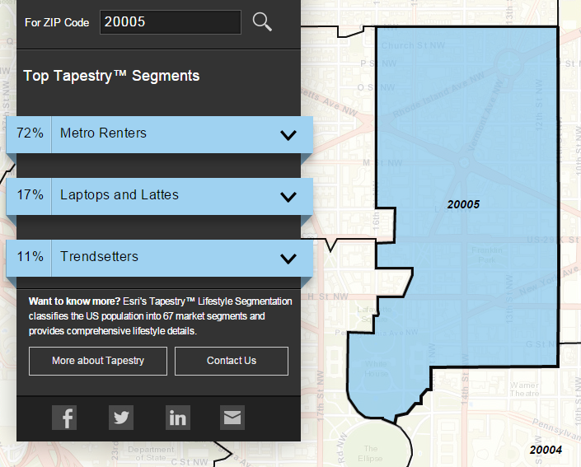
UNSUPERVISED LEARNING
Group US residential neighborhoods into 67 unique segments based on demographic and socioeconomic characteristics
Metro Renters:
Young, mobile, educated, or still in school, we live alone or with a roommate in rented apartments or condos in the center of the city. Long hours and hard work don’t deter us; we’re willing to take risks to get to the top of our professions… We buy groceries at Whole Foods and Trader Joe’s and shop for clothes at Banana Republic, Nordstrom, and Gap. We practice yoga, go skiing, and attend Pilates sessions.
Source: http://www.esri.com/landing-pages/tapestry/

Slide 57
UNSUPERVISED LEARNING
Common types of unsupervised learning:
Clustering: group “similar” data points together
Dimensionality Reduction: reduce the dimensionality of a dataset by extracting features that capture most of the variance in the data

Slide 58
UNSUPERVISED LEARNING
Unsupervised learning has some clear differences from supervised learning. With unsupervised learning:
There is no clear objective
There is no “right anwser” (hard to tell how well you are doing)
There is no response variable, just observations with features
Labeled data is not required

Slide 59
UNSUPERVISED LEARNING
Unsupervised learning example: Coin clustering
Observations: Coins
Features: Size and mass
Response: There isn’t one (no hand-labeling required!)
Perform unsupervised learning
Cluster the coins based on “similarity”
You’re done!
Sometimes, unsupervised learning is used as a “preprocessing” step for supervised learning. (How?)

Slide 60
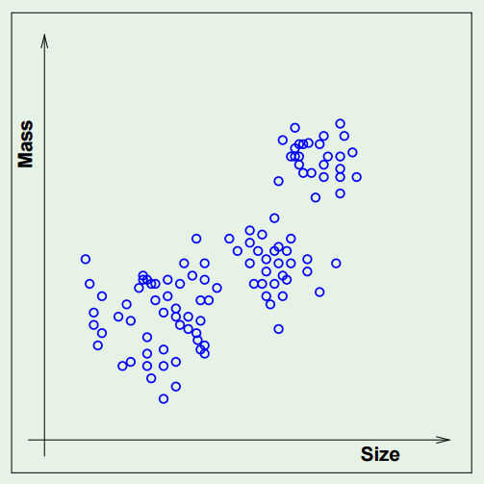
UNSUPERVISED LEARNING

